Slide 1

“SRS OF CHAT APP ”
Task - 1

Slide 2

Chat-App
It enables you to send and receive messages. Chatting apps make it easier, simpler, and faster to connect with everyone and it is also easy to use. There are many types of chatting apps and every one has its own format, design, and functions.
▪
NM ID | NAME | BATCH
au820420205013 | Arun R | CF1
au820420205018 | Divya R | CF1
au820420205028 | Jothikumar K | CF1
au820420205033 | Mahalakshmi S | CF1

Slide 3

Task-1
Creation of SRS & Githu
Create SRS:“Chat app”
Creation &Set-up of Git hub account
Creation& Hands-on to various commands of Git Bash
▪
▪
▪
Evaluation Metric:
● 100% Completion of the above tasks
Learning Outcome
These learning outcomes can be tailored to your specific goals and the intended audience of your chat app. Whether you are developing a chat app for personal use, a small group, or a large-scale commercial product, the learning outcomes will vary in scope and complexity.

Slide 4
Step-Wise Description
Project Introduction:
Begin by introducing the project and its purpose.Provide background information, including the project's objectives and goals.
Scope Definition:
Define the scope of the project by specifying what the software will and will not do.Describe any limitations or constraints that may impact the project.
Functional Requirements:
List all the functional requirements of the system.Use clear, concise language and include detailed descriptions of each requirement.
Organize the requirements into sections or categories based on their functionality (e.g., user authentication, data management, user interface).
Testing Requirements:
Outline the testing strategy, including unit testing, integration testing, and user acceptance testing.Specify test cases and criteria for success.

Slide 5
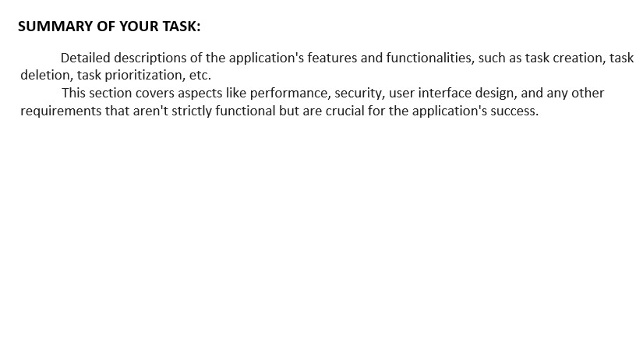
Detailed descriptions of the application's features and functionalities, such as task creation, task deletion, task prioritization, etc. This section covers aspects like performance, security, user interface design, and any other requirements that aren't strictly functional but are crucial for the application's success.
SUMMARY OF YOUR TASK:
A chat app, also known as a messaging application, is a software platform that enables users to engage in real-time text-based communication with one another, typically over the internet. Popular examples of chat apps include WhatsApp, Facebook Messenger, Telegram, Signal, and Slack. These apps have evolved to include a wide range of features and capabilities, making them central to modern communication for individuals, businesses, and organizations.

Slide 6

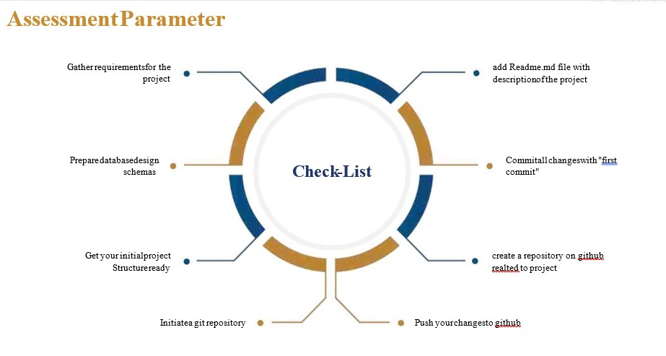

Slide 7

Submission Github
https://github.com/ArunR4/NM2

Slide 8


